Slide 1
BC Aboriginal Funding Conference
Vancouver - September 22, 2016

Slide 2
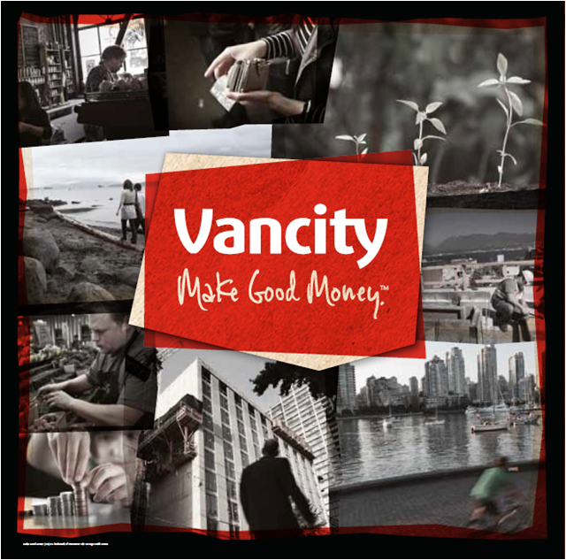
Notes:
A little bit about Vancity
Our organization was founded in 1946 to provide financial services to people who were unable to access traditional sources of financing
Today we are the largest member owned, community based, financial services co-operative in Canada, with $19 billion in assets, Over 500,000 members and 59 branches located throughout the traditional territories of the Coast Salish People as well as Alert Bay, in the traditional territory of the Kwakwaka'wakw People.
We are committed to a new definition of wealth, where the well being of people and communities is more than simply financial, and by working together we can all thrive and prosper.

Slide 3
Guiding Principles
Co-operative principles and practices are flourishing in the community
Social justice and financial inclusion are enhanced in our members’ communities
Environmental sustainability of our members’ lives and their communities are enhanced
Notes:
Community capacity and asset building
Support for Aboriginal not for profit and First Nation government organizations
Access to financial services for under banked and underserved individuals
Affordable housing on and off reserve
Access to financing for entrepreneurs, small businesses, and social enterprises
Sustainable environmental practices

Slide 4
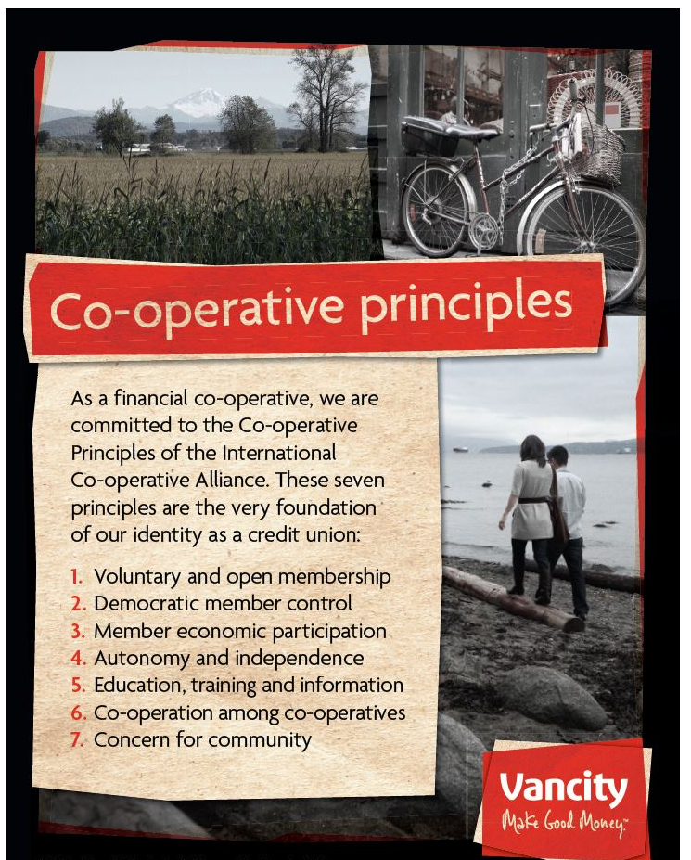

Slide 5
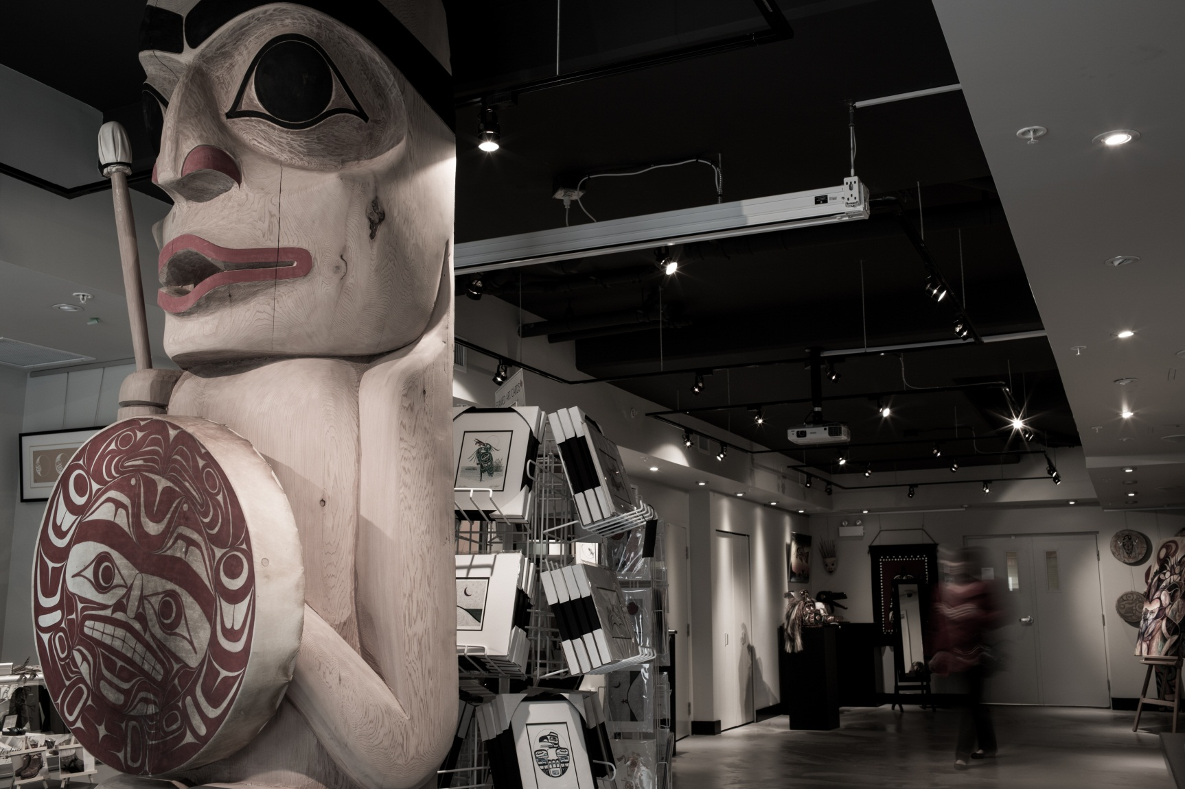
Investing for Impact

Slide 6
Programs
Local Branch Grants
Community Project Grants
Strategic and Mission Based Grants
Envirofund
Social Purpose Real Estate
Notes:
Community investment
Vancity and other financial institutions are community assets. How we invest and operate affects our community’s well-being, which is a responsibility we take seriously.
We offer excellent service, financial advice and competitive products and services to help our members build their own wealth. Then we use members’ deposits to lend and invest in local businesses and organizations that create positive economic, social and environmental impact in our communities. We also combine this lending and investing with advice, advocacy, partnerships and grants. That is what we call ‘community investment’.
Branch community impact
Community volunteer opportunities
Community donation opportunities
Community Investment experts
Financial literacy
Impact lending and investment programs

Slide 7

Provided a tailored financing solution for building purchase
Participate in partners for social impact roundtable
Have become the primary banker for BC Association of Aboriginal Friendship Centres
Provided various small grants to support events and projects
Participated in board and strategic planning
Worked with the BC Association of Aboriginal Friendship Centres to support the development of social enterprises
Each One, Teach One, financial literacy programs
Working together to identify new programs and initiatives to support youth and families
Hand Up
Hand Up
Notes:
The BC Association of Aboriginal Friendship Centres is the umbrella association for 25 Friendship Centres located in communities throughout BC. The Association is based in Victoria, employs over 40 full time staff and manages a budget of about $15 million annually. We have a decade long relationship with the BCAAFC and have worked with them in a number of ways that reflect a partnership based on trust, a respectful understanding of our shared goals and values and the concept of reciprocity. Let’s explore how we Make Good Money with this partner example. We have:
Provided some small grants to support projects and events, including
Supported the back to school back pack program
Attended and supported the annual gathering our voices youth conference
Bought tickets and attended their fundraising events
Worked with various Friendship Centres to deliver financial literacy and entrepreneurship workshops
participated in strategic planning and board capacity building programs
We have become their primary banker, so most of their banking needs: accounts, cash management, payroll, lending – with us.
In 2013, we provided them with a financing solution – a large loan – to allow them to purchase their new offices Victoria without requiring a 25% down payment – which let them acquire real estate now and not wait for a capital campaign to raise the required funds
Supported the development of social enterprise in Aboriginal Friendship Centres, one good example of this is the catering business of the Vancouver Aboriginal Friendship Centre.
We supported an Aboriginal Social Innovation conference to bring thought leaders together under the direction of the BCAAFC to look at innovation within the Aboriginal not for profit sector
We invited the BCAAFC to participate in the Partners for Social Impact roundtable which is looking at new ways for the community sector to fund the delivery of programs and service – social impact bonds is one example of this work
This relationship has allowed Vancity to provide financial service and financial literacy solutions to employees and participants in local Friendship Centre programs. Our partnership is more than grants and financial services, we also are working on a number of projects and initiatives in the area of social innovation – together we are looking at opportunities to diversify funding with social impact bonds and community bonds, and are sitting at government/private sector roundtables on economic inclusion and social entrepreneurship.

Slide 8
Vancity contacts
Stewart Anderson, Manager, Indigenous Partnerships
To learn more about our work with Aboriginal Not for Profit and First Nation government organizations visit www.vancity.com/aboriginalcommunities
www.vancity.com/grants

Slide 9
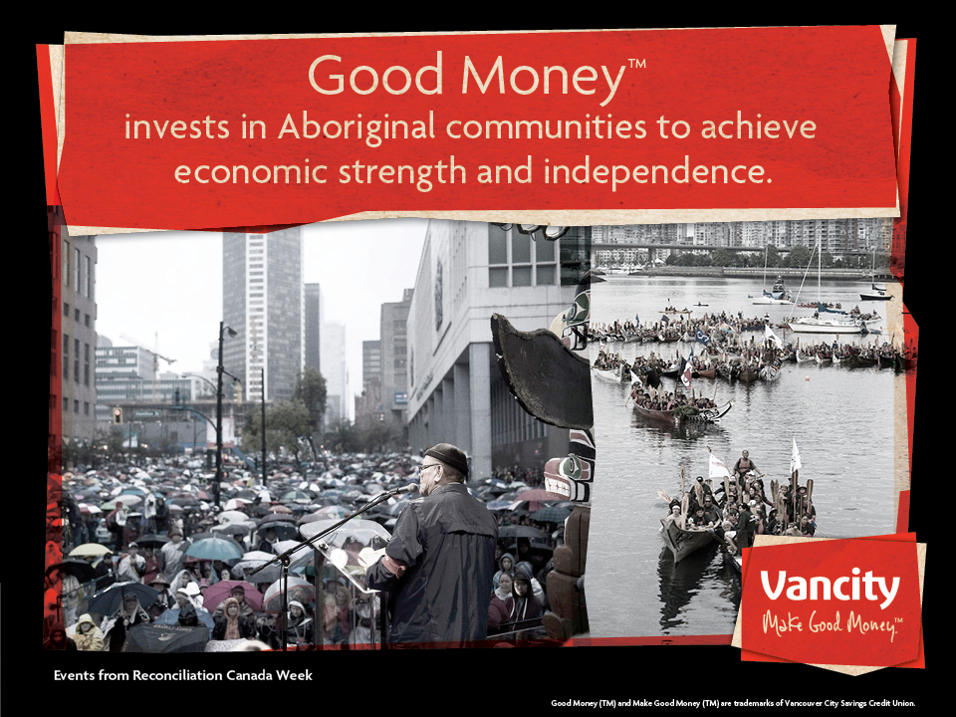
Notes:
Vancity is all about Good MoneyTM
Our promise to members is ‘to make you good money by putting money to good.’
Good money is changing how we see wealth and transforming the place where we live. It’s members helping members meet their financial goals no matter how big or small.
Good Money at Vancity sees the big picture because it knows our neighbours don’t just live next door. It supports companies that are sustainable now so that we can all be better off in the future. It gets behind growing businesses. It knows that making the right transaction today can support your long term plan. And we know we need to be a little more savvy and do more with what we have. Good money understands that what goes around, comes around, back to our members’ prosperity.
At Vancity we’re about being good with money. Here’s how...

